Slide 1

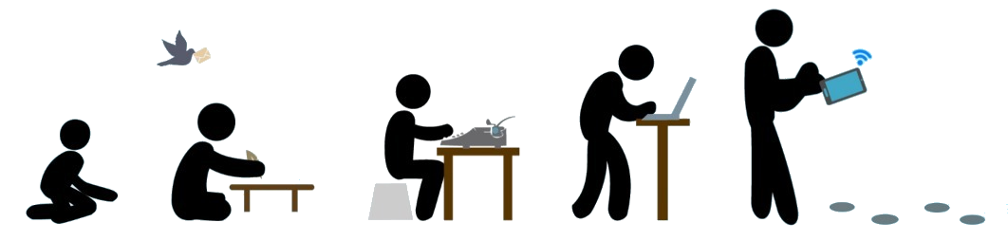
Evolution of Communication Technology from Ancient Times to Modern Times by NARENDER KESWANI [24]

Slide 2
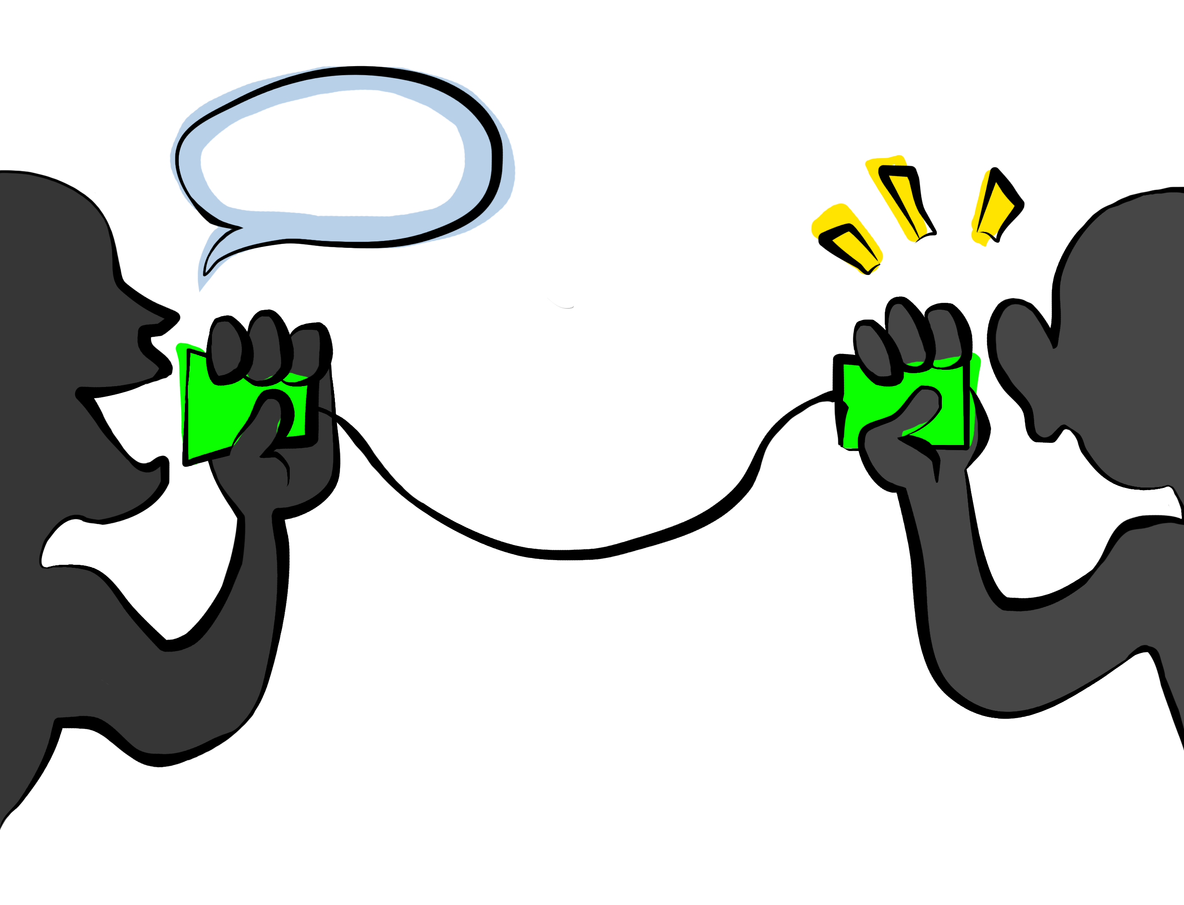
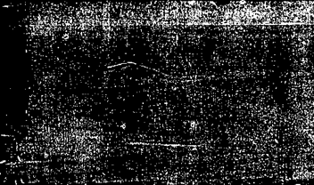
Communication

Slide 3
Communication
Expressing ideas
Understandings
Verbal
Non-Verbal
Written

Slide 4
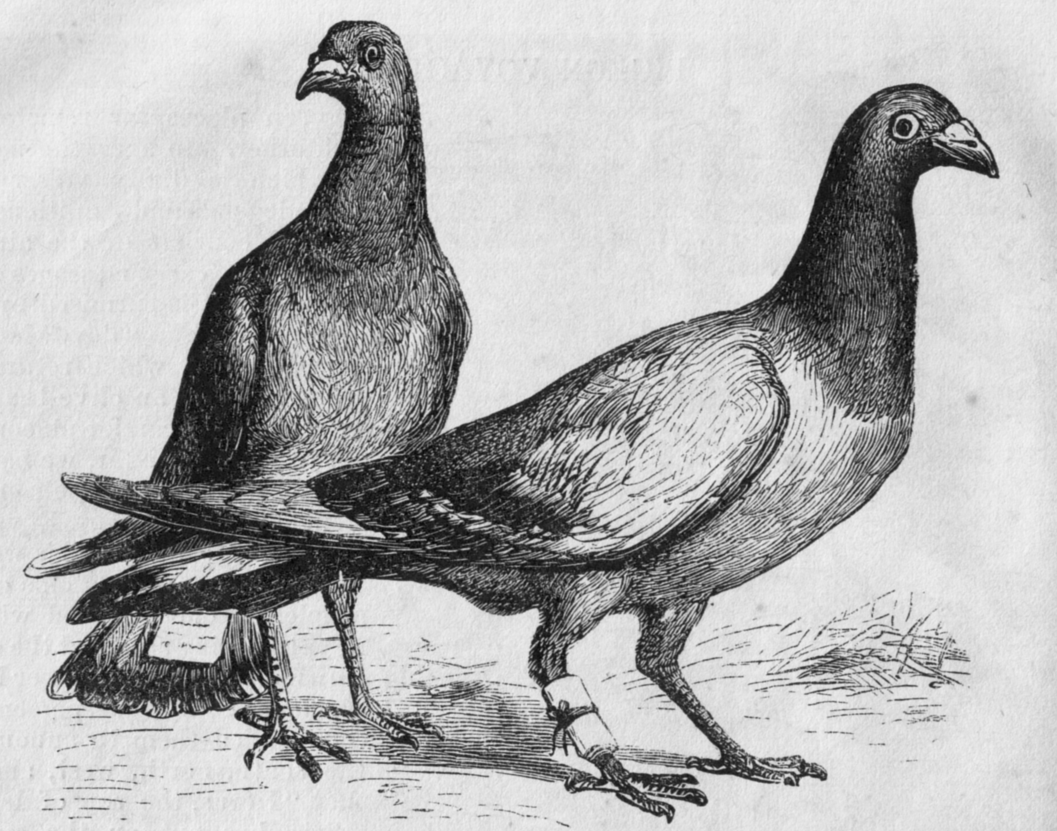
Pigeon

Slide 5
Pigeon
Pigeon post was invented by ALBERT VUONG IN 630 AD.
The pigeons were transported to a destination in cages, where they would be attached with messages, then naturally the pigeon would fly back to its home where the owner could read their mail.
It is first form of air mail. Mainly used by the romans at that time. Used by military , etc. Used in II nd world war
Advantages:
Reliable -98% accuracy
Fast
Cost Effective
They live for 5-18 years
Disadvantages:
Training – required from experts
Birds can die while transporting the message

Slide 6
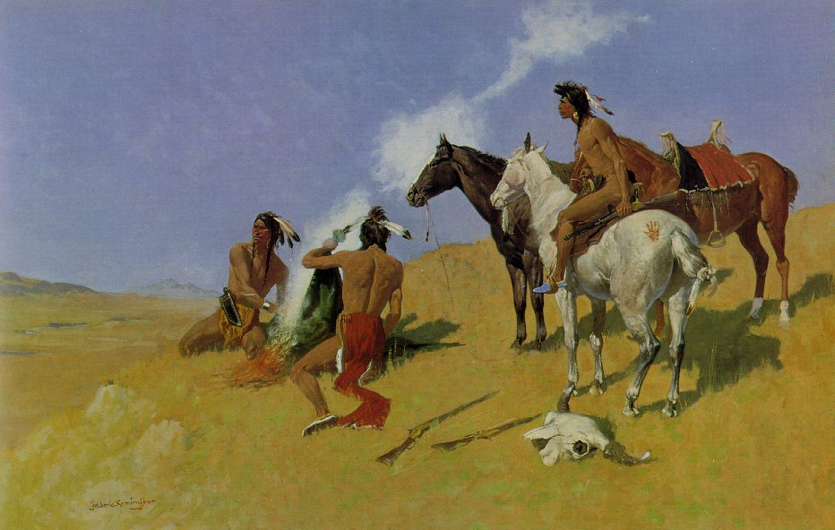
Smoke Signal

Slide 7
Smoke Signal
Oldest form of long distance communication.
Visual communication over long distance.
It is used to alert people if there is any danger or attack.

Slide 8
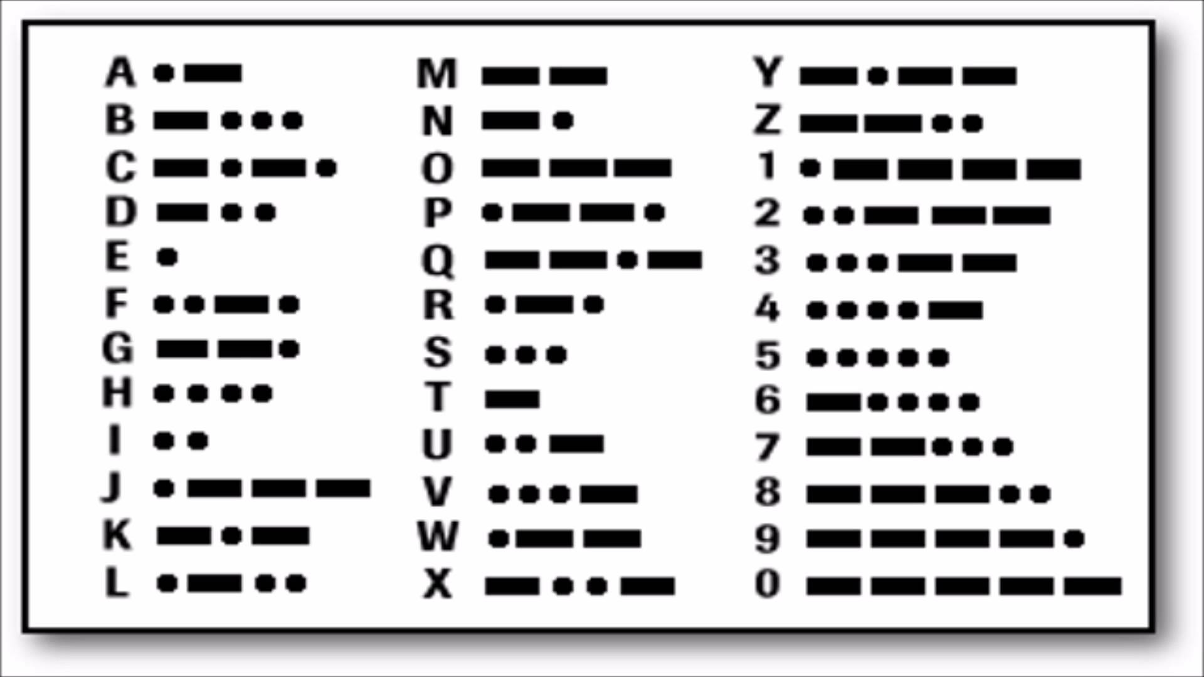
Morse code

Slide 9
Morse code
Invented by an American called Samuel Finley Breese Morse, (1791-1872). He was not only an inventor but also a famous painter.
Morse code is a character encoding scheme used in telecommunication that encodes text characters as standardized sequences of two different signal durations called dots and dashes or dits and dahs.
Speed of transmit & receive is 20-30 WPM

Slide 10
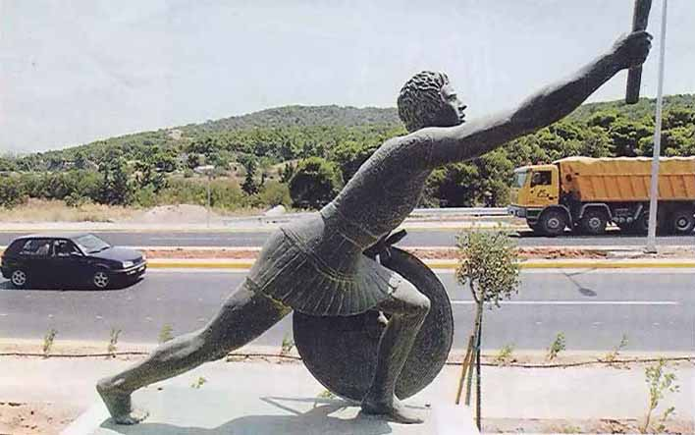
Marathon Man

Slide 11
Marathon Man
530 BC
Humans used to go to different places themselves to deliver a message
People used to run miles to send message and announcements such as winning a war.

Slide 12
Mail

Slide 13
Mail
The first documented use of organized courier service is in Egypt in 2400 B.C., where Pharaohs used couriers to send out decrees throughout the territory of the State.
The earliest surviving piece of mail is also Egyptian, which dates back to 255 BC.

Slide 14
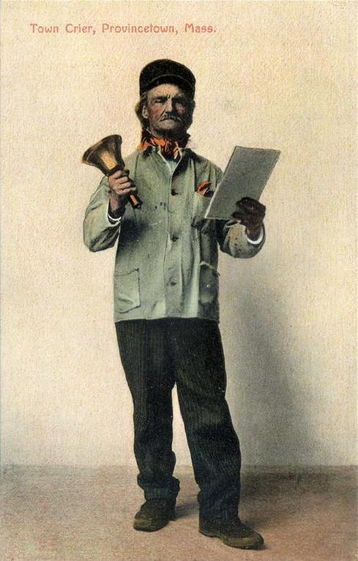
Bellman

Slide 15
Bellman
Bellman , also called as town crier
A town crier is a person who make public announcements in the streets. They carry a handbell to make a loud noise and they shout the words.
They carry a handbell to attract people's attention, as they shout the words "Oyez, Oyez, Oyez!" before making their announcements. The word "Oyez" means "hear ye,“
In many parts of India, the village crier traditionally carried a rustic drum to call public attention, following up with the message. The message had a typical flow, starting with "people of (...) village, the headman would like to announce that..." followed by the message.

Slide 16
Paper(Newspaper)

Slide 17
Paper(Newspaper)
The modern newspaper is a European invention.
The oldest direct ancestors of the modern newspaper were the handwritten news sheets that circulated widely in Venice as early as 1566.

Slide 18
Telephone

Slide 19
Telephone
Antonio Meucci, 1854, constructed telephone-like devices. Alexander Graham Bell was awarded the first U.S. patent for the invention of the telephone in 1876.
The impact of telephone on business.

Slide 20
TV

Slide 21
TV
Electronic television was first successfully demonstrated in San Francisco on Sept. 7, 1927. The system was designed by Philo Taylor Farnsworth

Slide 22
E-Mail

Slide 23
E-Mail
History of email > 50 years
Computer-based mail and messaging became possible with the advent of time-sharing computers in the early 1960s, and informal methods of using shared files to pass messages were soon expanded into the first mail systems.
Most developers of early mainframes and minicomputers developed similar, but generally incompatible, mail applications. Over time, a complex web of gateways and routing systems linked many of them. Many US universities were part of the ARPANET, which aimed at software portability between its systems. That portability helped make the Simple Mail Transfer Protocol (SMTP) increasingly influential.

Slide 24
Internet

Slide 25
Internet
Sharing of information, ideas, or simply words over the World Wide Web, or the Internet.
The Internet consists of a worldwide string of connected networks that exchanges data through packet switching using the standardized Internet Protocol Suite (TCP/IP). Unlike before, people can stay at home and be connected to his or her family, friends, and even colleagues from anywhere around the world.

